Slide 1
CORPORATE PROFILE

Slide 2
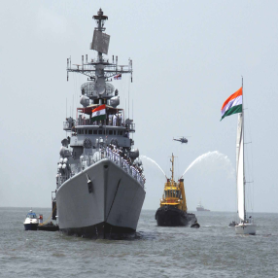
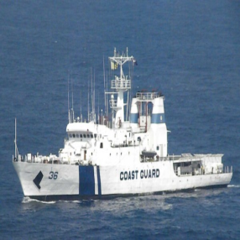
BACKGROUND
Incorporated in 2007 in Singapore
Digital Nanotech is a 100% subsidiary of M/s Si2 Microsystems Private Limited, India (Si2)
Military Broking License issued by Govt. of Singapore
Working with various government agencies including Indian Air Force, Indian Army, Indian Navy, Govt. of Singapore.
Si2 Microsystems was established in 1996 in Bangalore, India.
Si2 has manufacturing facilities in India and the United States.
Manufacturing Partner with UralVagonZavod, Russian Federation (OEM of T-72 and T-90 tanks) for Indian market
Customers include BEL, ISRO, ADE, HAL (India), DRDO, MBDA Missile Systems, France, Elisra EW Systems, Israel etc.

Slide 3
BACKGROUND
Projects Handled :
Production of sub-systems for the Light Combat Aircraft for Indian Air Force
Upgradation of Pechora Air Defence Missile Systems – Indian Air Force
Repair and overhauling of OSA and Kvadrat Air Defence Missile Systems – Indian Air Force
Repair and overhauling of BMP1 and BMP2 – Indian Army
Repair and overhauling of Mig-27, Mig-29 and Su-30 – HAL
Design and manufacture of Test Jig for MICA Missile – MBDA Missile Systems, France
Design and manufacture of Electronic Warfare Suite (Anti-Jammers) for Indian Air Force for Light Combat Aircraft
Supply of 125MM AFSPS Shells to the Indian Army
Supply of spares, upgradation and modernisation of the T-72 and T-90 tanks of the Indian Army
Supply of small arms to several countries

Slide 4
BACKGROUND

Slide 5
PRODUCTS OFFERED
We work with various partners in Israel, Ukraine, Bulgaria, Russia and Belarus including State owned companies such as BSVT, Belarus, for sourcing of military parts and complete equipment. Our partners have been in this business for more than 25 years.
Product Range Offered :
Heavy Machine Guns:
12.7 mm DSHK, NSVT
Ammunition
7,62x39, 7,62x51, 7,62x54, 5,45x39, 9x18 and 9x19
Thermobaric Ammunition, Rockets and Bombs
Grenade Launchers:
RPG-7, SPG-9, MUHA and all other grenade launchers
Jammers – all types
Body Armor
Helicopters
MI-8, MI-17, MI-24, Mi-26 all modifications and payloads
Aeroplanes
AN-32, AN-74 etc.
Infantry weapons: All models of AK 7.62×39, 7.62×54, 5.45 and other calibres, new production and in storage.
.

Slide 6
HELICOPTERS
MI-8, MI-17, MI-171E, MI-24, Mi-26
Old (refurbished) as well as new
Civilian and military versions available
Armored versions available
Payload available :
S-5 and S-8 Rockets
12,7 mm Gatling gun
7,62 mm Gatling gun
Gun GSh - L 23 mm
Grenade launcher 30 mm
Rocket pod for rockets 57 mm
Rocket pod for rockets 80 mm
Anti-tank guided supersonic missile 130 mm
Gun pod for gun GSh-23 L
Universal gun pod (1 x 9-A-800 or 1 x 9-A-624 + 2 x 9-A-622)
Mine warfare container
Bombs
Transport container for 9M114
Flares launcher

Slide 7
OTHER MILITARY EQUIPMENT
Mig-29’s (refurbished)
T-72M1 and T-72A Tanks
Multiple Launch Rocket System BM-21 GRAD with 122mm Rockets
BTR-80M APC’s
Anti-Tank Missile Launcher / KONKURS and FAGOT Missiles
Amphibious MTLB’s

Slide 8
ARMS
Pistols – 9x17mm (0.38 Cal), 9x18mm and 9x19mm
9mm revolvers and semi-automatic guns
9x19mm Sub-machine Guns
AK-47M, AK-47S guns
5.56mm Assault rifle
5.56mm Light Machine Gun
Infantry calibre 23mm (ZU-23-2 Towed) guns
BKC Machine Gun Cal 7.62mm
Dushka 12.7mm calibre single barrel machine gun
SPG-9, RPG-7 projectile/rocket launchers

Slide 9
AMMUNITION
9mm ammunition – various types
7.62x39mm ammunition
23mm ammunition
7.62x54mm ammunition
12.7x108mm ammunition
Projectiles for SPG-9,
Rockets for RPG-7
Mortars – 60mm, 80mm and 120mm

Slide 10
THERMOBARIC AMMUNITION
57mm UAR
80mm UAR-80TВ Grenade
122mm Rocket
Aviation bomb ВАТВ 100-120
Aviation bomb ВАТВ 250-270
120mm mortar bomb VDMM 120 TB (aluminum body)
82 mm mortar bomb OF ТB (steel body)
120 mm mortar bomb OF ТB (steel body)
82mm mortar bomb VDMM 82 TB (aluminum body)

Slide 11
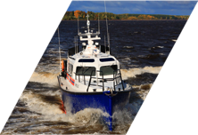
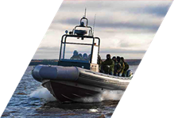
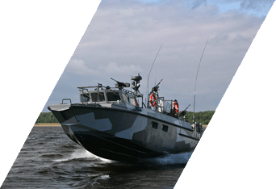
POWER BOATS
LIDER 10
LIDER 11
LIDER 12
LIDER 17
UMK-20V
Multi-Purpose
Search-and-Rescue Powerboat
Multi-Purpose
Fire and Rescue Powerboat
Multi-Purpose
Fire and Rescue Powerboat
Multi-Purpose Patrol Powerboat
Multi-Purpose Search-and-Rescue Powerboat
Overall length, m - 13.90
Overall beam, m - 4.51
Transport height, m - 3.83
Draft, m - 0.73
Displacement, m³ - 14.60
Main engine power, kW (hp) - 2 х 423 (2 х 575)
Maximum speed, knots - 35
Sea endurance, days - 3
Crew / special personnel / total number of persons onboard, person - 2 / 2 / 24
Hull and superstructure material - Marine grade aluminium
Fuel capacity, l - 3200
Potable water capacity, l - 60
Maximum range (miles) at speed: 30 knots - 500; 20 knots - 600; 10 knots - 800; 8 knots - 1500
BK-10
BK-16
High-Speed Assault Powerboat
High-Speed Assault Powerboat

Slide 12
STAR RADAR
STAR S-90 (Surveillance and Target Acquisition Radar) is a FMCW ground-based radar for military and security applications.
Automatically detects moving targets, such as walking persons, vehicles and flying objects like gliders and helicopters at ranges of up to 24 km.
Lightweight, easily deployed, user friendly, reliable and cost-effective
Operates 24 hours a day, even under poor weather and low visibility conditions.

Slide 13
NCST SERIES COASTAL SURVEILLANCE RADAR
NCST8-25: ANTENNA LENGTH 8ft, PULSE POWER 25kW and
NCST12-25: ANTENNA LENGTH 12ft, PULSE POWER 25kW
Fully functional coastal surveillance radar with downmast and up-mast transceiver solutions:
Available in double and single transceiver units ► Antenna lengths of 8ft and 12ft provide high detection performance and resolution capability
Using non-standard transmission frequencies to avoid interference from shipborne radars
Digitally generated STC curve with selectable modes for different sea clutter and weather conditions
Automatic acquisition and tracking (ARPA) - simultaneously tracking up to 1024 moving targets with maximum speed of 100kts Application range: Coastal surveillance radar stations, traffic control stations

Slide 14
FIELD COMMUNICATION & INFORMATION SYSTEM

Slide 15
VIP SECURITY - JAMMERS
Radio-Jammers are used against Remote controlled explosives and eavesdropping:
Portable Radio Jammer type
Stationary Radio Jammer type
Mobile Radio Jammer Station type with frequency range from 2 to 6000MHz and Output Power from 600W to 3400W according to the requirement of the Buyer
Artillery Radio Jammer / 122mm, 152mm and 155mm rounds
Radio Jammer for unmanned aircraft
GPS Radio Jammer /No 307 of Export list
Radio Jamming Device for Surveillance and Jamming Video Cameras, type CCJ-2.4

Slide 16
ARTILLERY JAMMERS
ARTILLERY BEARERS CARRIED RADIOJAMMERS
Radiojammers create jamming in the enemy tactical units operating in the frequency range 1,5120 MHz (Tactical HF and VHF bands)
Radiojammers provide effective radio jamming to all types of radios – fixed and hopping.
ARTILLERY SHELL CALIBER:
122mm
152mm
130 mm
155 mm
Other calibres according to customer request

Slide 17
ANTI JAMMERS
Jamming Resistant GNSS Receiver
CRPA
Antijam protection in dynamic multi-jammer scenarios
Compatible with legacy GNSS Receivers
Low cost jammer protection for any application
The small size makes it easy to integrate
Upto 50 dN of additional anti-jamming protection (reduction of suppressed area range is upto 300 times)
Adaptive digital nulling
Affordable protection for GNSS position, velocity and time
Single enclosure system
GLONASS, GPS, Galileo L1 support

Slide 18
Handheld Explosive Detection Device – HEDD1

Slide 20
NIGHT VISION DEVICES

Slide 21
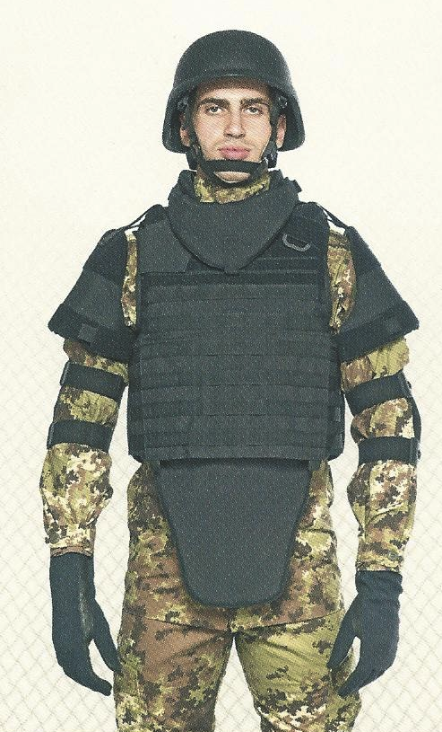
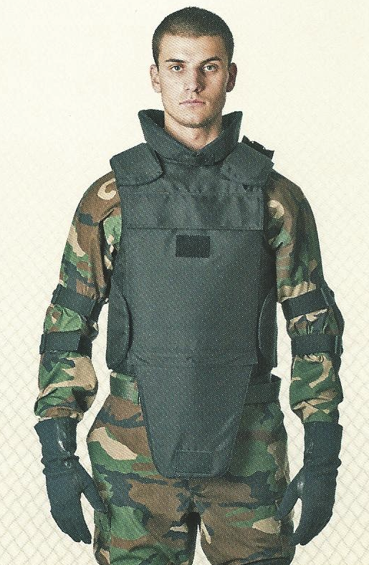
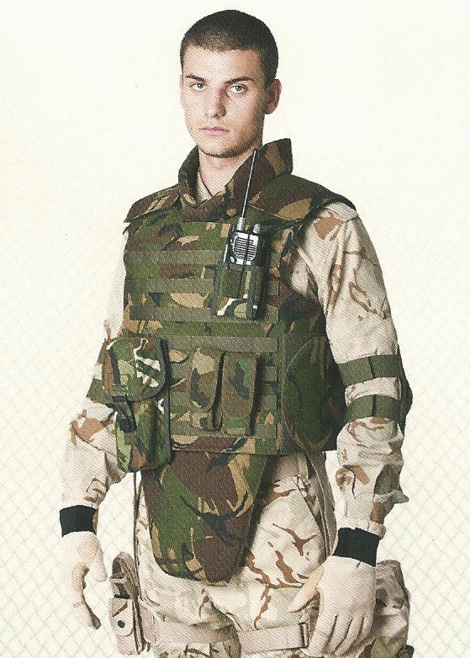
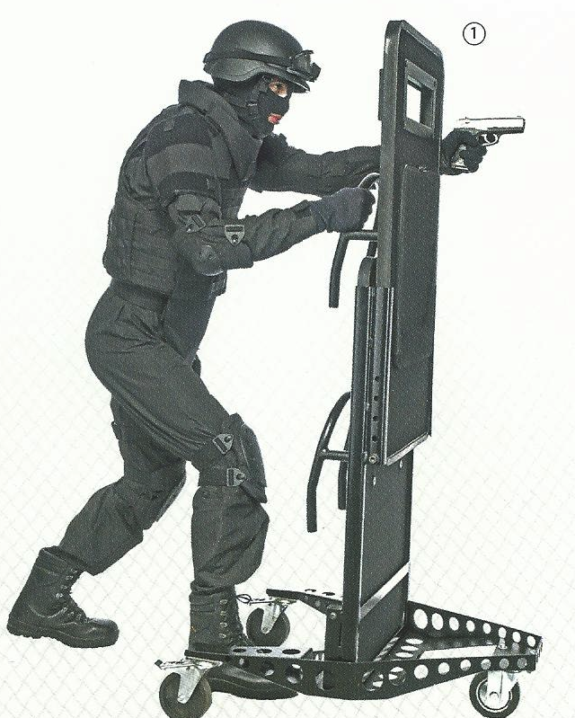
BODY ARMOR
Combat Helmets : extensive Ballistic protection tested according to STANAG 2920, NIJ 0106.01
Ballistic Shield : MARS Armor Ballistic Shield is tested and certified according to NIJ.0109.00
Ballistic Body Armor – various types

Slide 22
OTHER EQUIPMENT
Binoculars : Night and Day Vision
Non-contact anti-armour vehicles and trucks mines : in the fuse there are sensors for the noise of the engine and for the pressure/from the weight of vehicle/. By remote control device we can activate and deactivate this mine field with these clever mines.
Anti-helicopter mines : for air protection of the objects. The mines are designed to destroy low flying helicopters within 100m range.
HP-100 Portable Ground Radar for Surveillance and Target Acquisition :Specially used for the protection of very important object against the terrorists. The radar automatically detects moving ground targets, to identify them and to determine their co-ordinates at any time of the year and at absence of optical visibility /presence of fog, dust, smoke, etc/. It can be used to protect sensitive sites / nuclear power station, airports, warehouses, borders, pipelines, etc.
Mobile Thermo vision Surveillance System “Terma”- for determination during the day and night of the targets real time with passive detection of IR emission

Slide 23
THANK YOU

